Slide 1
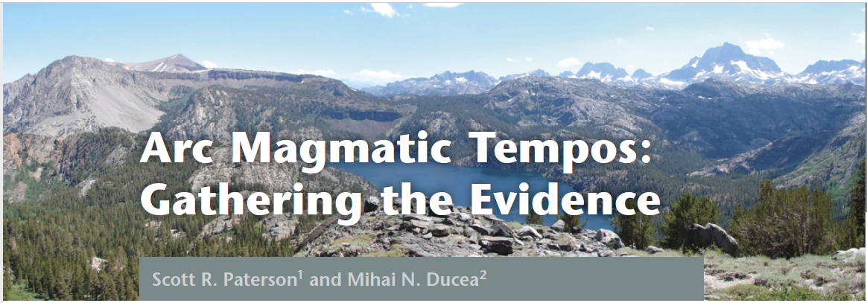
Elements: 2015, presentation by Kurt Kraal

Slide 3
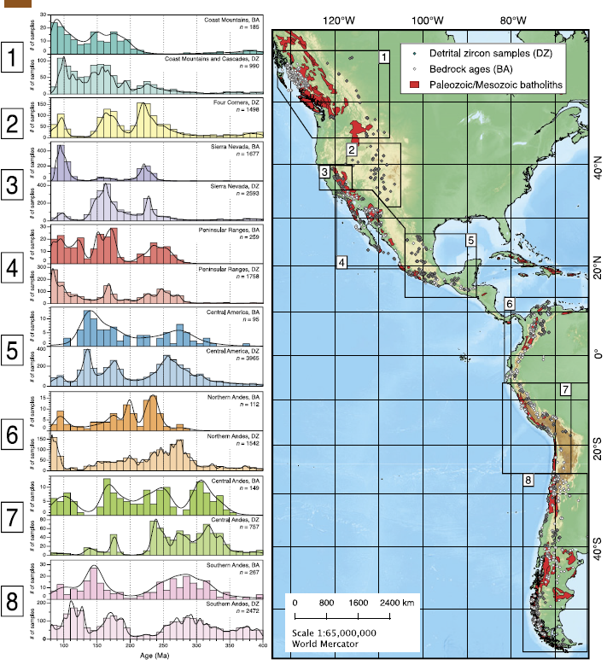
Episodic Magmatism
Based on Zircon data, Episodic magmatism seems to be the case world wide
Episodic characteristics have been observed at scales ranging from entire arcs to single volcanos
Arcs can have “flare-ups” over ~30 MY windows, and then have “lulls” with little magma addition
Global fluctuations in Arc Magmatism has been observed worldwide as well
Observed best in continental arcs, partly because oceanic arcs are poorly preserved, and also generally more mafic (and therefore less zircon)

Slide 4
Magma Addition Rates
Magma Addition Rates (MAR) vary through time, in a wave-like pattern of magmatism (Figure C)
There is a wavelength (spacing) of flareups, and variations in amplitude (i.e. volume of magmatism). These combined are called “arc tempos”
Changes in magmatism can be related to external forcing on arc systems (e.g. change in mantle flow, plate reconfigurations, collisions) or internal cyclic processes driven by a feedback between tectonic and magmatic processes
Detrital Zircon can provide information about timing and duration but not necessarily the volumes of high/low MARs.
To determine Mars, temporal data is linked to geologic maps showing area of igneous rocks, retrodeformation of igneous units, estimates of vertical thickness and volumes of volcanic and plutonic units, calculation of the volume of magma added per time increment

Slide 5
Sierra Nevada
This plot shows waxing and waning patterns
Flare-ups represent 100-1000 times greater magma added than during lulls
Plutonic footprints are often greater than volcanic caps: 30:1 ratio of plutonic to volcanic rocks, perhaps greater
MAR calculations systematically underestimate volumes of older magmatic materials (because older materials are magmatically eroded or recycled)

Slide 6
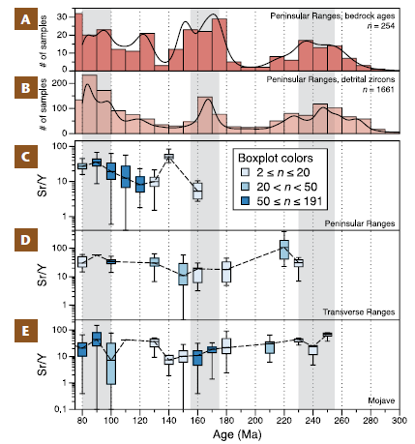
Isotope and Trace Element Chemistry and MAR episodes
Changes in isotope and trace element chemistry in arcs often correlate with high MAR episodes
Example:
most high MAR events are accompanied by high Sr/Y and La/Yb ratios
High values are measured in magmas of high SiO2, of 60%, suggesting that these events took place while the crust was thicker than normal
Other isotope values suggest greater input of upper plate’s lithosphere

Slide 7
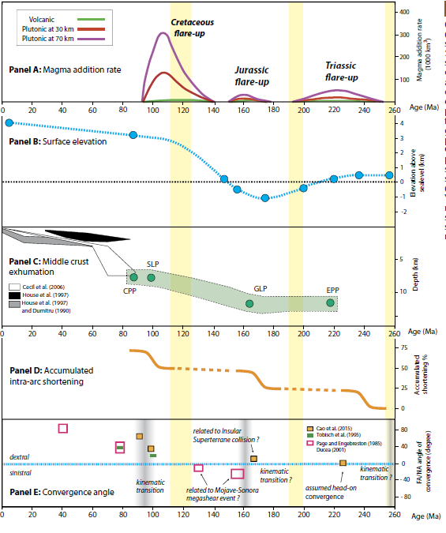
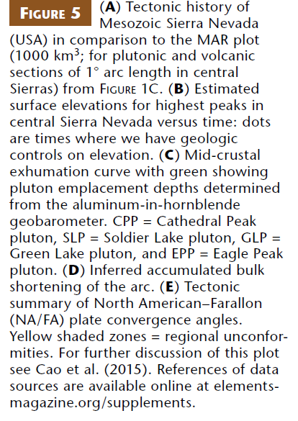
Possible Mechanisms for episodic arcs:
Mantle-lithosphere interactions
Jurassic Flare-up related to the break up of Gondwana and its associated change in plate motions.
Late Cretaceous Cordilleran flare-up possibly related to an increase in oceanic crust production rates and/or plate reorganizations
Feedback between linked tectonic processes (foreland shortening, underthrusting of foreland material into lower crustal parts of arcs, crustal thickening and mountain building), sedimentary erosion, and magmatic processes.
decompression melting within the mantle wedge and modulated by the thickness of the upper plate
episodic volatile fluxing into the mantle wedge, episodic melting scenarios, and the modulating effects of thick continental crust on rising magmas
Thermal lags likely to occur between tectonic change and magmatism effects

